Slide 1



Noida Institute of Engineering and Technology, Greater Noida
UNDERSTANDING BLOCKCHAIN TECHNOLOGY WITH CRYPTOCURRENCY
UNIT 2
Unit: 2
UNDERSTANDING BLOCKCHAIN TECHNOLOGY WITH CRYPTOCURRENCY(ACSAI0601)
Ms. Barkha Bhardwaj Assistant Professor
B.Tech AI
Course Details (B Tech 6th Sem)

Slide 2
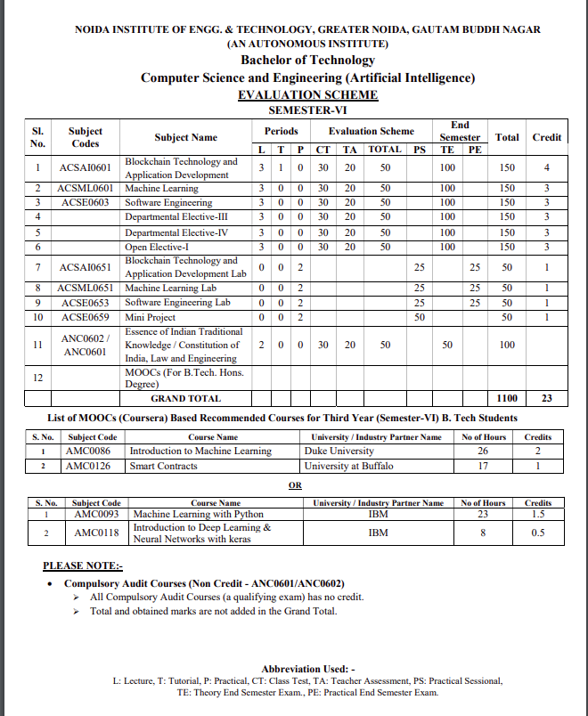
Noida Institute of Engineering and Technology, Greater Noida

Slide 3
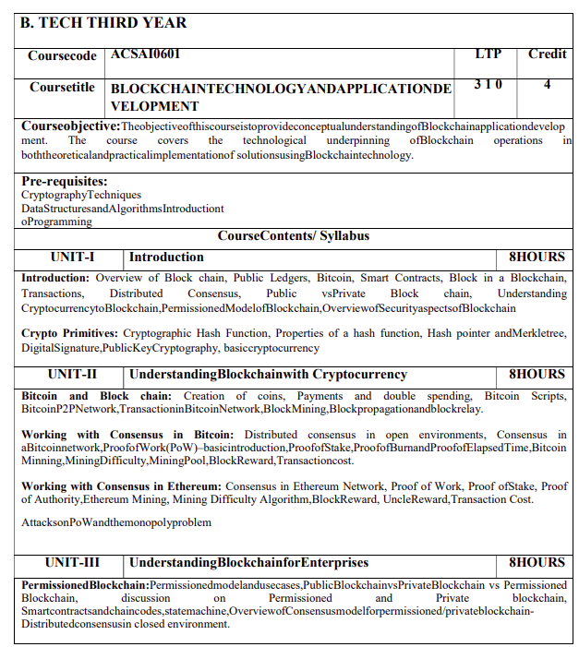
Noida Institute of Engineering and Technology, Greater Noida
Syllabus

Slide 4
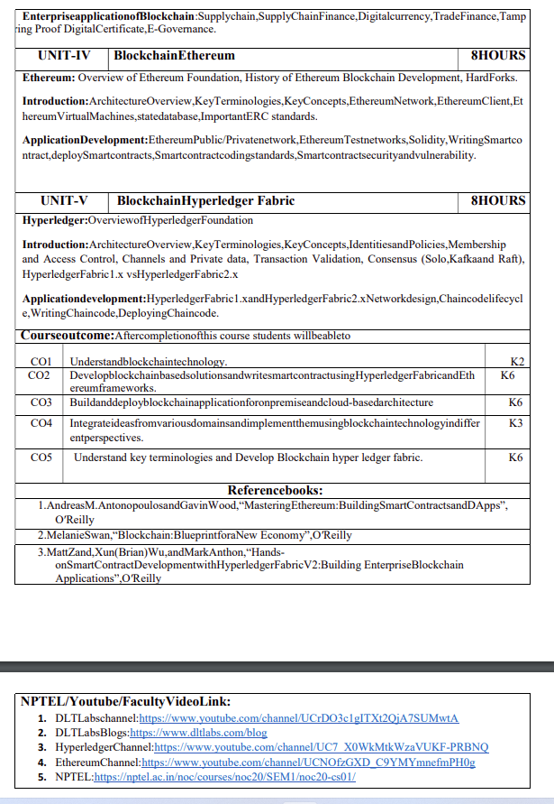
Noida Institute of Engineering and Technology, Greater Noida
Syllabus

Slide 5
Branch Wise Applications
It can compute man-made problems as well as natural phenomena. Block Chain theory has a lot of applications in real life as well, such that in SCM,education ,security ,banking and many fields.

Slide 6
Course Objective
To assess blockchain applications in a structured manner.
To impart knowledge in block chain techniques and able to present the concepts clearly and structured.
To get familiarity with future currencies and to create own crypto token.

Slide 7
Course Outcome
Course Outcome (CO) |  | Bloom’s Knowledge Level (KL)
At the end of the course, the student will be able to understand
CO 1 | Understand block chain technology. |  | K2
CO 2 | Develop block chain based solutions and write smart contract using Hyper ledger Fabric and Ethereum frameworks. |  | K6
CO 3 | Buildanddeployblockchainapplicationforonpremiseandcloud-basedarchitecture |  | K6
CO 4 | Integrate ideas from various domains and implement them using block chain technology in differ ent perspectives. |  | K3
CO 5 | Understand key terminologies and Develop Block chain hyper ledger fabric. |  | K6

Slide 8
Program Outcomes
Engineering Graduates will be able to Understand:
1. Engineering knowledge
2. Problem analysis
3. Design/development of solutions
4. Conduct investigations of complex
5. Modern tool usage
6. The engineer and society
7. Environment and sustainability
8. Ethics
9. Individual and team work
10. Communication
11. Project management and finance
12. Life-long learning

Slide 9
CO-PO and PSO Mapping
CO-PO correlation matrix of Block Chain and Application Development(ACSAI0601)
 | PO1 | PO2 | PO3 | PO4 | PO5 | PO6 | PO7 | PO8 | PO9 | PO10 | PO11 | PO12
ACSAI0601 | 2 | 2 | 3 | 3 | 2 | 2 | - | - | 2 | 1 | - | 3
ACSAI0601 | 1 | 3 | 2 | 3 | 2 | 2 | - | 1 | 1 | 1 | 2 | 2
ACSAI0601 | 2 | 2 | 3 | 2 | 2 | 2 | - | 2 | 2 | 1 | 2 | 3
ACSAI0601 | 2 | 2 | 2 | 3 | 2 | 2 | - | 2 | 2 | 1 | 1 | 3
ACSAI0601 | 3 | 2 | 2 | 2 | 2 | 2 | - | 2 | 1 | 1 | 1 | 2
Average | 2 | 2.2 | 2.4 | 2.6 | 2 | 2 | - | 1.4 | 1.6 | 1 | 1.2 | 2.6
Mapping of Program Specific Outcomes and Course Outcomes:

Slide 10
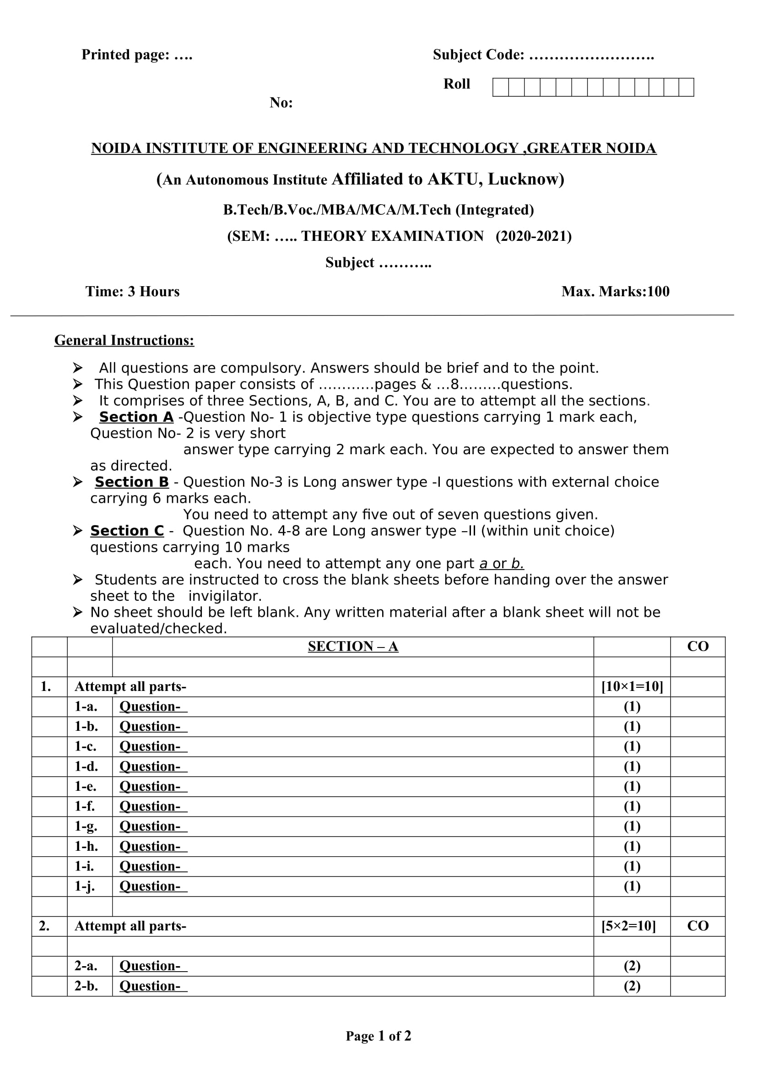
End Semester Question Paper Templates (Offline Pattern/Online Pattern)
End Semester Question Paper Templates (Offline Pattern/Online Pattern)

Slide 11
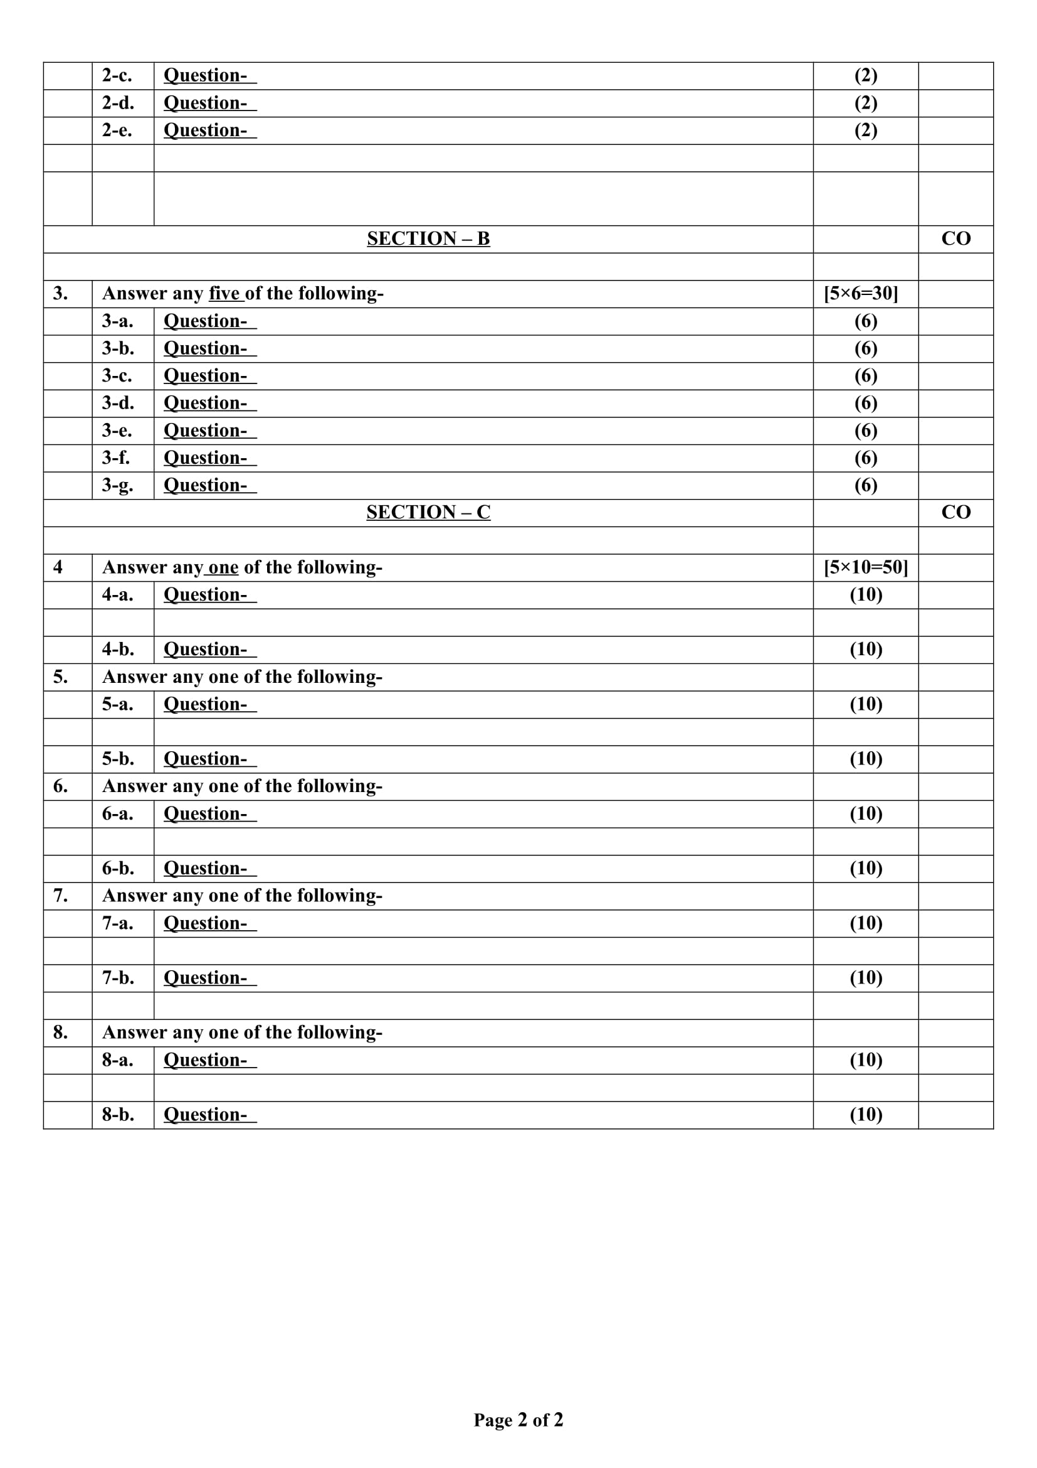
End Semester Question Paper Templates (Offline Pattern/Online Pattern)

Slide 12
Prerequisite and Recap
Brief input about the block chain and its introduction in the different fields. The basics of the Cyber security and cryptography are the requirements of this course.

Slide 13
Brief Introduction about the Subject with videos
Blockchain is a buzzword in today’s technology and this technology is described as the most disruptive technology of the decade.
Thus, Blockchain is used for the secure transference of items like money, contracts, property rights, stocks, and even networks without any requirement of Third Party Intermediaries like Governments, banks, etc.
DLTLabschannel:https://www.youtube.com/channel/UCrDO3c1gITXt2QjA7SUMwtA
DLTLabsBlogs:https://www.dltlabs.com/blog
HyperledgerChannel:https://www.youtube.com/channel/UC7_X0WkMtkWzaVUKF-PRBNQ
EthereumChannel:https://www.youtube.com/channel/UCNOfzGXD_C9YMYmnefmPH0g
NPTEL:https://nptel.ac.in/noc/courses/noc20/SEM1/noc20-cs01/

Slide 14
Contents
Brief Introduction about the Subject with videos
Bit Coin
Double Spending
P2P Network
Consensus in bitcoin
Bitcoin Mining
Consensus in Ethereum
PoW and its Significance

Slide 15
Brief Introduction about the Subject with videos
Blockchain is a buzzword in today’s technology and this technology is described as the most disruptive technology of the decade.
Thus, Blockchain is used for the secure transference of items like money, contracts, property rights, stocks, and even networks without any requirement of Third Party Intermediaries like Governments, banks, etc.
DLTLabschannel:https://www.youtube.com/channel/UCrDO3c1gITXt2QjA7SUMwtA
DLTLabsBlogs:https://www.dltlabs.com/blog
HyperledgerChannel:https://www.youtube.com/channel/UC7_X0WkMtkWzaVUKF-PRBNQ
EthereumChannel:https://www.youtube.com/channel/UCNOfzGXD_C9YMYmnefmPH0g
NPTEL:https://nptel.ac.in/noc/courses/noc20/SEM1/noc20-cs01/

Slide 16
Unit Objective
To understand the basic concept of the block chain.
To understand the concepts of the cryptocurrency.
To understand the cryptographic hash functions and PoW.
To understand the Public key cryptography and Stale Block.
To understand the concept of the double spending and bitcoin mining.

Slide 17
Unit II Syllabus
Introduction :
Bitcoin and Block chain: Creation of coins, Payments and double spending,
ScriptsBitcoinP2PNetwork,TransactioninBitcoinNetwork,BlockMining,
Block propagation and block relay. Working with Consensus in Bitcoin: Distributed consensus in open environments,
Consensus in a Bitcoin network, Proof of Work(PoW)–basic introduction, Proof of Stake, Proof of Burn and Proof of Elapsed Time ,Bitcoin Mining ,Mining Difficulty ,Mining Pool ,Block Reward ,Transaction cost.
Working with Consensus in Ethereum: Consensus in Ethereum Network, Proof of Work, Proof of Stake, Proof of Authority ,Ethereum Mining, Mining Difficulty Algorithm ,Block Reward, Uncle Reward, Transaction Cost. Attacks on PoW and the mono poly problem.

Slide 18
Introduction (CO2)
INTRODUCTION TO BITCOIN:
Bitcoin is the first application of the blockchain technology.Bitcoin has started a revolution with the introduction of the very first fully decentralized digital currency, and one that has proven to be extremely secure and stable. This has also sparked a great interest in academic and industrial research and introduced many new research areas. Since its introduction in 2008, bitcoin has gained much popularity and is currently the most successful digital currency in the world with billions of dollars invested in it.
It is built on decades of research in the field of cryptography, digital cash, and distributed computing. In the following section, a brief history is presented in order to provide the background required to understand the foundations behind the invention of bitcoin.

Slide 19
Introduction (CO2)
Bitcoin: A Peer-to-Peer Electronic Cash System was written by Satoshi Nakamoto. The first key idea introduce was that purely peer-to-peer electronic cash that does need an intermediary bank to transfer payments between peers. Bitcoin is built on decades of cryptographic research such as the research in Merkle trees, hash functions, public key cryptography, and digital signatures. Moreover, ideas such as BitGold, b-money, hashcash, and cryptographic time stamping provided the foundations for bitcoin invention.
All these technologies are cleverly combined in bitcoin to create the world's first decentralized currency. Bitcoin can be defined in various ways: it's a protocol, a digital currency, and a platform. It is a combination of peer-to-peer network, protocols, and software that facilitate the creation and usage of the digital currency named bitcoin. Note that Bitcoin with a capital B is used to refer to the Bitcoin protocol, whereas bitcoin with a lowercase b is used to refer to bitcoin, the currency. Nodes in this peer-to-peer network talk to each other using the Bitcoin protocol.

Slide 20
Decentralization (CO2)
Decentralization of currency was made possible for the first time with the invention of bitcoin. Moreover, the double spending problem was solved in an elegant and ingenious way in bitcoin.
Double spending problem arises when, for example, a user sends coins to two different users at the same time and they are verified independently as valid transactions. Bitcoin Working Mechanism: When you send an email to another person, you just type an email address and can communicate directly to that person. It is the same thing when you send an instant message.
This type of communication between two parties is commonly known as Peer-to-Peer communication. Whenever you want to transfer money to someone over the internet, you need to use a service of third-party such as banks, a credit card, a PayPal, or some other type of money transfer services. The reason for using third-party is to ensure that you are transferring that money. In other words, you need to be able to verify that both parties have done what they need to do in real exchange.
For example, Suppose you click on a photo that you want to send it to another person, so you can simply attach that photo to an email, type the receiver email address and send it. The other person will receive the photo, and you think it would end, but it is not. Now, we have two copies of photo, one is a simple email, and another is an original file which is still on my computer. Here, we send the copy of the file of the photo, not the original file. This issue is commonly known as the double-spend problem.

Slide 21
Decentralization(CO2)
The double-spend problem provides a challenge to determine whether a transaction is real or not. How you can send a bitcoin to someone over the internet without needing a bank or some other institution to certify the transfer took place. The answer arises in a global network of thousands of computers called a Bitcoin Network and a special type of decentralized laser technology called blockchain.
Transactions & Structure: Transactions are at the core of the bitcoin ecosystem. Transactions can be as simple as just sending some bitcoins to a bitcoin address, or it can be quite complex depending on the requirements. Each transaction is composed of at least one input and output. Inputs can be thought of as coins being spent that have been created in a previous transaction and outputs as coins being created. If a transaction is minting new coins, then there is no input and therefore no signature is needed. If a transaction is to sends coins to some other user (a bitcoin address), then it needs to be signed by the sender with their private key and a reference is also required to the previous transaction in order to show the origin of the coins. Coins are, in fact, unspent transaction outputs represented in Satoshis.

Slide 22
Transactions(CO2)
Transactions are not encrypted and are publicly visible in the blockchain. Blocks are made up of transactions and these can be viewed using any online blockchain explorer. The transaction life cycle 1. A user/sender sends a transaction using wallet software or some other interface. 2. The wallet software signs the transaction using the sender's private key. 3. The transaction is broadcasted to the Bitcoin network using a flooding algorithm. 4. Mining nodes include this transaction in the next block to be mined. 5. Mining starts once a miner who solves the Proof of Work problem broadcasts the newly mined block to the network. 6. The nodes verify the block and propagate the block further, and confirmation starts to generate. 7. Finally, the confirmations start to appear in the receiver's wallet and after approximately six confirmations, the transaction is considered finalized and confirmed. However, six is just a recommended number, the transaction can be considered final even after the first confirmation. The key idea behind waiting for six confirmations is that the probability of double spending is virtually eliminated after six confirmations.

Slide 23
Types of transaction: (CO2)
Types of transaction:
There are various scripts available in bitcoin to handle the value transfer from the source to the destination. These scripts range from very simple to quite complex depending upon the requirements of the transaction. Standard transactions are evaluated using IsStandard() and IsStandardTx() tests and only standard transactions that pass the test are generally allowed to be mined or broadcasted on the bitcoin network. However, nonstandard transactions are valid and allowed on the network. Pay to Public Key Hash (P2PKH): P2PKH is the most commonly used transaction type and is used to send transactions to the bitcoin addresses.
The format of the transaction is shown as folows: ScriptPubKey: OP_DUP OP_HASH160 OP_EQUALVERIFY OP_CHECKSIG ScriptSig: The ScriptPubKey and ScriptSig parameters are concatenated together and executed. Pay to Script Hash (P2SH): P2SH is used in order to send transactions to a script hash (that is, the addresses starting with 3) and was standardized in BIP16. In addition to passing the script, the redeem script is also evaluated and must be valid. The template is shown as follows: ScriptPubKey: OP_HASH160 OP_EQUAL ScriptSig: [...] MultiSig (Pay to MultiSig): M of n multisignature transaction script is a complex type of script where it is possible to construct a script that required multiple signatures to be valid in order to redeem a transaction. Various complex transactions such as escrow and deposits can be built using this script. The template is shown here: ScriptPubKey: [ . . . ] OP_CHECKMULTISIG ScriptSig: 0 [ . . . ] Raw multisig is obsolete, and multisig is usually part of the P2SH redeem script, mentioned in the previous bullet point. Pay to Pubkey: This script is a very simple script that is commonly used in coinbase transactions. It is now obsolete and was used in an old version of bitcoin. The public key is stored within the script in this case, and the unlocking script is required to sign the transaction with the private key. The template is shown as follows: OP_CHECKSIG Null data/OP_RETURN: This script is used to store arbitrary data on the blockchain for a fee. The limit of the message is 40 bytes. The output of this script is unredeemable because OP_RETURN will fail the validation in any case. ScriptSig is not required in this case.

Slide 24
Types of transaction: (CO2)
P2PKH script execution: All transactions are eventually encoded into the hex before transmitting over the bitcoin network. Blockchain is a public ledger of a timestamped, ordered, and immutable list of all transactions on the bitcoin network. Each block is identified by a hash in the chain and is linked to its previous block by referencing the previous block's hash. In the following structure of a block, a block header is described, followed by a detailed diagram that provides an insight into the blockchain structure.
The Genesis Block: This is the first block in the bitcoin blockchain. The genesis block was hardcoded in the bitcoin core software. Bitcoin provides protection against double spending by enforcing strict rules on transaction verification and via mining. Blocks are added in the blockchain only after strict rule checking and successful Proof of Work solution. Block height is the number of blocks before a particular block in the blockchain. The current height (at the time of writing this) of the blockchain is 434755 blocks. Proof of Work is used to secure the blockchain. Each block contains one or more transactions, out of which the first transaction is a coinbase transaction. There is a special condition for coinbase transactions that prevent them to be spent until at least 100 blocks in order to avoid a situation where the block may be declared stale later on

Slide 25
Stale blocks (CO2)
Stale blocks are created when a block is solved and every other miner who is still working to find a solution to the hash puzzle is working on that block. Mining and hash puzzles will be discussed later in the chapter in detail. As the block is no longer required to be worked on, this is considered a stale block. Orphan Blocks : are also called detached blocks and were accepted at one point in time by the network as valid blocks but were rejected when a proven longer chain was created that did not include this initially accepted block. They are not part of the main chain and can occur at times when two miners manage to produce the blocks at the same time.
The Bitcoin Network : The bitcoin network is a P2P network where nodes exchange transactions and blocks. There are different types of nodes on the network. There are two main types of nodes, full nodes and SPV nodes. Full nodes, as the name implies, are implementations of bitcoin core clients performing the wallet, miner, full blockchain storage, and network routing functions. However, it is not necessary to perform all these functions. SPV nodes or lightweight clients perform only wallet and network routing functionality. The latest version of Bitcoin protocol is 70014 and was introduced with bitcoin core client 0.13.0.

Slide 26
Introduction to bitcoin block chain (CO2)
The term ‘Blockchain mining’ is used to describe the process of adding transaction records to the bitcoin blockchain. This process of adding blocks to the Blockchain is how transactions are processed and how money moves around securely on Bitcoins. This process of Blockchain mining is performed by a community of people around the world called ‘Blockchain miners.’ Anyone can apply to become a Blockchain miner. These Blockchain miners install and run a special Blockchain mining software that enables their computers to communicate securely with one another. Once a computer installs the software, joins the network, and begins mining bitcoins, it becomes what is called a ‘node.’ Together, all these nodes communicate with one another and process transactions to add new blocks to the blockchain which is commonly known as the bitcoin network. This bitcoin network runs throughout the day. It processes equivalent to millions of dollars in bitcoin transactions and has never been hacked or experienced downtime since its launch in 2009.

Slide 27
Types of Mining (CO2)
Types of Mining
The process of mining can get really complex and a regular desktop or PC cannot cut it. Hence, it requires a unique set of hardware and software that works well for the user. It helps to have a custom set specific to mining certain blocks.
The mining process undertaking can be divided into three categories:
1. Individual Mining
When mining is done by an individual, user registration as a miner is necessary. As soon as a transaction takes place, a mathematical problem is given to all the single users in the blockchain network to solve. The first one to solve it gets rewarded.
Once the solution is found, all the other miners in the blockchain network will validate the decrypted value and then add it to the blockchain. Thus, verifying the transaction.
2. Pool Mining
In pool mining, a group of users works together to approve the transaction. Sometimes, the complexity of the data encrypted in the blocks makes it difficult for a user to decrypt the encoded data alone. So, a group of miners works as a team to solve it. After the validation of the result, the reward is then split between all users.
3. Cloud Mining
Cloud mining eliminates the need for computer hardware and software. It’s a hassle-free method to extract blocks. With cloud mining, handling all the machinery, order timings, or selling profits is no longer a constant worry.
While it is hassle-free, it has its own set of disadvantages. The operational functionality is limited with the limitations on bitcoin hashing. The operational expenses increase as the reward profits are low. Software upgrades are restricted and so is the verification process.

Slide 28
Block Propagation Time(CO2)
The lack of scalability is known to be the foremost obstacle standing in the way of mass adoption of blockchain technology.
All existing blockchain projects look for solutions that could improve the performance of their network.
After the invention of decentralized peer-to-peer network Bitcoin, researchers got interested in what determines the limits of Bitcoin’s scaling.
block propagation time or block propagation delay.
It is an average time that is needed for the new block to reach most nodes in the network.
In a large-decentralized network like Bitcoin, whenever the new block is generated, it is broadcasted according to the Gossip protocol.
If some node has got the new valid block, it informs nodes connected to it about its new possession.
Then the node transfers this block to those nodes which asked it to do that. Before the block reaches each full-node in the network, it passes through 7 intermediary nodes.

Slide 29
DISTRIBUTED CONCENSUS
DISTRIBUTED CONCENSUS IS REQUIRED TO DECIDE 1. of all messages coming in concurrently how are they ordered 2. But if some of the crowd are malicious, and tries to allow data that are wrong, or ordered wrong? 3. You need Byzantine fault‐tolerant consensus.
Consensus is the process by which peers agree to the addition of next block in the block chain. Distributed Consensus ensures that different nodes in the network see the same data at​
nearly the same point of time. Hence in case of any failure, the system can still provide a service as the data is decentralised. To maintain anonymity in this large network, the permission less protocol is used where you don’t need to record your identity while participating in the consensus.​
​
Consensus Algorithms​
We know that Blockchain is a distributed decentralized network that provides immutability, privacy, security, and transparency. There is no central authority present to​
validate and verify the transactions, yet every transaction in the Blockchain is considered to be completely secured and verified. This is possible only because of the presence of the consensus protocol which is a core part of any Blockchain network.​

Slide 30
Proof of Work (PoW):​ ​
Proof of Work (PoW):​
​
The idea for Proof of Work(PoW) was first published in 1993 by Cynthia Dwork and Moni Naor and was later applied by Satoshi Nakamoto in the Bitcoin paper in 2008. Proof of Work consensus is the mechanism of choice for the majority of cryptocurrencies currently in circulation. The term “proof of work” was first used by Markus Jakobsson and Ari Juels in a publication in 1999.​
rinciple: A solution that is difficult to find but is easy to verify.​
The purpose of a consensus mechanism is to bring all the nodes in agreement, that is, trust one another, in an environment where the nodes don’t trust each other.​
​
​
Working of POW(Proof of Work)​
​
“The Proof of Work consensus algorithm involves solving a computational challenging puzzle in order to create new blocks in the Bitcoin blockchain. Colloquially, the process is known as ‘mining’, and the nodes in the network that engage in mining are known as ‘miners’. The incentive for mining transactions lies in economic payoffs, where competing miners are rewarded with 12.5 bitcoins(at the time of writing this article; this reward will get reduced by half its current value with time) and a small transaction fee.”​

Slide 31
Bitcoin’s Proof-of-Work system:​
It is necessary for a steady and diminishing flow of new coins until the maximum number of 21 million is reached (expected some time with the current rate in around 2140)), the Bitcoin network regularly changes the difficulty level of mining a new block.​
The fact that Block GFG1 is connected to Block GFG2 through its hash number is important. The significance lies in the fact that this ‘hash number’ connects new block to the last block in the valid blockchain. If, on the other hand, the Block GFG1 Hash number on Block GFG2 had a different hash number than Block GFG1 they would not match up, and Block GFG2 would not be verified. First block in the blockchain is called the Genesis Block and has no Prev Block Hash value.​
​
Changing a block (which can only be done by making a new block containing the same predecessor) requires regenerating all successors and redoing the work they contain (amounting to calculating the entire chain of ‘hard mathematical problems’) which is practically impossible. This protects the blockchain from tampering.​
​
​
Bitcoin’s Proof-of-Work system:​
​
Bitcoin uses the Hashcash Proof of Work system as the mining basis. The ‘hard mathematical problem’ can be written in an abstract way like below :​
Given data A, find a number x such as that the hash of x appended to A results is a number less than B.​
The miners bundle up a group of transactions into a block and try to mine. To mine​
it, a hard mathematical problem has to be solved. This problem is called the proof of work problem which has to be solved to show that the miner has done some work in finding out the solution to the problem and hence the mined block must be valid. The answer to the​

Slide 32
Bitcoin’s Proof-of-Work system:​
problem needs to be a lower number than the hash of the block for it to be accepted, known as the ‘target hash’.A target hash is a number that the header of a hashed block must be equal to or less than for a new block, along with the reward, to be awarded to a miner. The lower a target is, the more difficult it is to generate a block.​
A miner continues testing different unique values (known as nonce(s)) until a suitable one is produced. The miner who manages to solve the problem gets the bitcoin reward and adds the block into the blockchain by broadcasting that the block has been​
mined. The target hash adjusts once every 2016 blocks or approximately once every 2 weeks. All the miners immediately stop work on the said block and start mining the next block.​
​
Common cryptographic protocols used in Proof of Work systems: The most widely used proof-of-work consensus is based on SHA-256 and was introduced as a part of Bitcoin. Others include Scrypt, SHA-3, scrypt-jane, scrypt-n, etc.​
​
​
Features of Proof of Work system:​
There are mainly two features that have contributed to the wide popularity of this consensus protocol and they are:​

Slide 33
Main issues with the Proof-of-Work consensus:​
Main issues with the Proof-of-Work consensus:​
The Proof-of-Work consensus mechanism has some issues which are as follows:​
The 51% risk: If a controlling entity owns 51% or more than 51% of nodes in the network, the entity can corrupt the blockchain by gaining the majority of the network.​
Time consuming: Miners have to check over many nonce values to find the right solution to the puzzle that must be solved to mine the block, which is a time consuming​
process.​
Resource consumption: Miners consume high amounts of computing power in order to find the solution to the hard mathematical puzzle. It leads to a waste of precious resources(money, energy, space, hardware). It is expected that the 0.3% of the world’s​
electricity will be spent to verify transactions by the end of 2018.​

Slide 34
Cryptocurrencies using PoW:​
Transaction confirmation takes about 10–60 minutes. So, it is not an instantaneous transaction; because it takes some time to mine the transaction and add it to the blockchain thus committing the transaction.​
​Cryptocurrencies using PoW:​
Litecoin​ ,Ethereum​,Monero coin​,Dogecoin​
Proof of Stake (PoS):​
Proof of Stake (PoS) is a type of algorithm which aims to achieve distributed consensus in a Blockchain. This way to achieve consensus was first suggested by Quantum Mechanic here and later Sunny King and his peer wrote a paper on it. This led to Proof-of- Stake (PoS) based Peercoin. A stake is value/money we bet on a certain outcome. The​
process is called staking. A more particular meaning of stake will be defined later on.​
Need of Proof-of-Stake:​
Before proof of stake, the most popular way to achieve distributed consensus was through Proof-of-Work (implemented in Bitcoin). But Proof-of-Work is quite energy(electrical energy in mining a bitcoin) intensive. So, a proof-of-work based consensus mechanism increases an entity’s chances of mining a new block if it has more computation resources.

Slide 35
What Is Proof of Elapsed Time (PoET)?
What Is Proof of Elapsed Time (PoET)?
Proof of elapsed time (PoET) is a blockchain network consensus mechanism that prevents high resource utilization and energy consumption; it keeps the process more efficient by following a fair lottery system.
The algorithm uses a randomly generated elapsed time to decide mining rights and block winners on a blockchain network. By running a trusted code within a secure environment, the PoET algorithm also enhances transparency by ensuring lottery results are verifiable by external participants.

Slide 36
What Is Proof of Elapsed Time (PoET)?
Proof of elapsed time (PoET) is a consensus algorithm developed by Intel Corporation that enables permissioned blockchain networks to determine who creates the next block.
PoET follows a lottery system that spreads the chances of winning equally across network participants, giving every node the same chance.
The PoET algorithm generates a random wait time for each node in the blockchain network; each node must sleep for that duration.
The node with the shortest wait time will wake up first and win the block, thus being allowed to commit a new block to the blockchain.
The PoET workflow is similar to Bitcoin's proof of work (PoW) but consumes less power because it allows a node to sleep and switch to other tasks for the specified time, thereby increasing network energy efficiency.

Slide 37
Understanding Proof of Elapsed Time (PoET)
Understanding Proof of Elapsed Time (PoET)
A consensus mechanism is a method used by blockchain networks to verify transactions and create more blocks. Proof of elapsed time (PoET) is a consensus mechanism often used on permissioned blockchain networks to decide the mining rights or the block winners on the network. Permissioned blockchain networks are types that require any would-be participant to identify themselves before they are allowed to join.
The PoET network consensus mechanism needs to ensure two crucial factors. First, it ensures that the participating nodes genuinely select a time that is indeed random and not a shorter duration chosen purposely by the participants to win. Second, it establishes that the winner has completed the waiting time.

Slide 38
What Is a Proof of Burn for Cryptocurrency?
Proof of burn is one of the several consensus mechanism algorithms implemented by a blockchain network to ensure that all participating nodes come to an agreement about the true and valid state of the blockchain network. This algorithm is implemented to avoid the possibility of any cryptocurrency coin double-spending.
Proof of burn follows the principle of “burning” the coins held by the miners that grant them mining rights.

Slide 39
Cryptocurrencies
Cryptocurrencies use several methods to validate the data stored on their blockchains, including a method called "proof of burn."
Proof of burn is the third attempt at creating a system to deter fraudulent activity on a blockchain, while also improving the functioning of the blockchain as a tool for transactions.
Proof of work and proof of stake are also methods for preventing fraudulent activity on a blockchain; proof of work is the system employed by the original and most popular cryptocurrency, Bitcoin.

Slide 40
Understanding Proof Systems
The blockchain is the primary database of a cryptocurrency. It holds all transaction-related information on blocks and those blocks act as the data storage units of the blockchain. A block is written only when the blockchain nodes agree on a set of transactions that the nodes consider valid.
Due to the autonomous and decentralized nature of the blockchain network, an automated mechanism is required to ensure that the participating nodes agree on only valid transactions. This important task is performed by consensus-mechanism algorithms.

Slide 41
Bitcoin rewards
Bitcoin block rewards are new bitcoins awarded to cryptocurrency miners for being the first to solve a complex math problem and creating a new block of verified bitcoin transactions. The miners use networks of computers to do this, and every time a new block is created it is verified by all the other competing miners. Then a new math problem is introduced and the miners start over.

Slide 42
Understanding Block Rewards
The block reward provides an incentive for bitcoin miners to process transactions made with the cryptocurrency. Creating an immutable record of these transactions is vital for bitcoin to work as intended. The blockchain is like a decentralized bank ledger—one that can't be altered after being created. The miners are needed to verify the transactions and keep this ledger up to date. Block rewards, and to a lesser extent, transaction fees, are their payment for doing so.
Bitcoin was designed so that new bitcoins are created at a consistent pace. So the difficulty of the math problem is adjusted every two weeks to ensure a steady output of new bitcoins—roughly one block of transactions every 10 minutes.
Bitcoin's Block Rewards Vs. Ethereum's
Ethereum, bitcoin's main competitor as a cryptocurrency, also relies on block rewards to provide incentives to miners. With Ethereum, the reward is a digital token called "ether," which is rewarded each time a miner succeeds in providing the mathematical proof of a new block. As with bitcoin, miners are also awarded a transaction fee, known as a "gas" fee.
Unlike with bitcoin, there is no limit on the number of Ethereum ether tokens that can be created, and they are created at a much faster pace—in seconds, versus about 10 minutes. So the total number of blocks in the Ethereum chain is larger than in the bitcoin chain.

Slide 43
Understanding Block Rewards
The Ethereum network began by using a consensus mechanism that involved Proof-of-work (PoW). This allowed the nodes of the Ethereum network to agree on the state of all information recorded on the Ethereum blockchain and prevented certain kinds of economic attacks. However, Ethereum switched off proof-of-work in 2022 and started using proof-of-stake instead.
Proof-of-work is the underlying algorithm that sets the difficulty and rules for the work miners do on proof-of-work blockchains. Mining is the "work" itself. It's the act of adding valid blocks to the chain. This is important because the chain's length helps the network follow the correct fork of the blockchain. The more "work" done, the longer the chain, and the higher the block number, the more certain the network can be of the current state of things.

Slide 44
Consensus in Ethereum (CO2)
A consensus mechanism is a fault-tolerant mechanism that is used in computer and blockchain systems to achieve the necessary agreement on a single data value or a single state of the network among distributed processes or multi-agent systems, such as with cryptocurrencies. It is useful in record-keeping, among other things.
On the Bitcoin blockchain, for instance, the consensus mechanism is known as Proof-of-Work (PoW), which requires the exertion of computational power in order to solve a difficult but arbitrary puzzle in order to keep all nodes in the network honest.

Slide 45
Consensus in Ethereum (CO2)
In any centralized system, like a database holding key information about driving licenses in a country, a central administrator has the authority to maintain and update the database. The task of making any updates—like adding/deleting/updating names of people who qualified for certain licenses—is performed by a central authority who remains the sole in-charge of maintaining genuine records.
Public blockchains that operate as decentralized, self-regulating systems work on a global scale without any single authority. They involve contributions from hundreds of thousands of participants who work on verification and authentication of transactions occurring on the blockchain, and on the block mining activities.
In such a dynamically changing status of the blockchain, these publicly shared ledgers need an efficient, fair, real-time, functional, reliable, and secure mechanism to ensure that all the transactions occurring on the network are genuine and all participants agree on a consensus on the status of the ledger. This all-important task is performed by the consensus mechanism, which is a set of rules that decides on the legitimacy of contributions made by the various participants (i.e., nodes or transactors) of the blockchain.

Slide 46
Consensus in Ethereum (CO2)
Ethereum Mining Summary Ethereum mining is the process of maintaining the Ethereum ledger through solving complex mathematical problems. Unlike Bitcoin mining, Ethereum mining can be done with a Graphical Processing Unit (GPU) only. How to Start Mining Ethereum
Step 1 – Install your GPUs and set up your computer
Step 2 – Get an Ethereum wallet (Mist or MyEtherWallet)
Step 3 – Join an Ethereum mining pool
Step 4 – Start mining! Read more: A Beginner's Step-by-Step Guide to Profitable Ethereum Mining in 2022 | 99Bitcoins

Slide 47
Ethereum
Ethereum is requires mining just like Bitcoin. The only way to update a new block of Ethereum transactions is by mining that block. The best way to understand Ethereum mining thoroughly is to read (or watch) our guide on Bitcoin mining. However, while conceptually the two are much alike, there are significant technical differences. Some are more obvious; for example, Ethereum blocks are added every 15 seconds (on average) while Bitcoin blocks which are added every 10 minutes (on average). As a reward, Ethereum miners receive 2 ETH plus all transaction and code-processing fees (aka gas) contained in their block, plus a possible bonus for any uncles they include. As for the mining algorithm, Ethereum uses a hashing algorithm known as Ethash which is different than Bitcoin’s hashcash. Ethash is incompatible with the special hashing hardware (ASICs) developed for Bitcoin mining. Moreover, it’s a memory-hard algorithm; meaning it’s designed to resist the development of Ethereum-mining ASICs. Instead, Ethash is deliberately best-suited to GPU-mining. Hashrate, Difficulty and Price Assuming the amount of hardware dedicated to Ethereum mining is rising, why aren’t blocks being mined ever more rapidly. How come the average 15 second block time remains constant? Read more: A Beginner's Step-by-Step Guide to Profitable Ethereum Mining in 2022 | 99Bitcoins

Slide 48
Ethereum
The mining difficulty of a cryptocurrency such as Bitcoin indicates how difficult and time-consuming it is to find the right hash for each block.
Mining difficulty is a measurement unit used in the process of Bitcoin mining
Difficulty indicates how difficult it is to solve a complex cryptographic puzzle
The difficulty of mining new units increases or decreases over time, depending on the number of miners in the network
Increases in difficulty are necessary in order to keep the target block time

Slide 49
What is an uncle block?
An uncle block is a block that did not get mined onto the canonical chain. Only one block can be mined and acknowledged as canonical on the blockchain. The remaining blocks are uncle blocks. When two or more miners produce blocks at nearly the same time, uncle blocks are created.
Uncle blocks are similar to orphan blocks on Bitcoin but have subtle distinctions connected with the Ethereum protocol. Uncle blocks are valid blocks that the network has rejected. Miners get paid for producing an uncle block, unlike an orphan block, where miners don't get rewarded.

Slide 50
What is an uncle block?
Why do uncle blocks occur?
Uncle blocks occur when two or more miners create blocks at almost the same time.
Uncle blocks occur because nodes on a network do not immediately accept a block into the blockchain. As a result, another miner can build and propagate their block at a similar time. To confirm the legitimacy of constructed blocks, they must be broadcast throughout the network to all nodes, which may cause latency concerns.
Ethereum introduces the uncle block technique to tackle the orphan block's security issues while improving transaction processing efficiency.
What are uncle block rewards?
Uncle block rewards are rewards awarded to miners who create an uncle block included in a valid block added to the chain.
Uncle blocks are similar to stale blocks in bitcoin, except instead of being ignored, uncle blocks are awarded dependent on how new they are, with the most significant payout being 4.375 eth. An example of this reward can be found here.
How do uncle block rewards get mined?
When miners of the main chain block reference uncle blocks, both the miner of the main chain block and the miner of the uncle block receive an additional reward.
Each block in the main chain can reference up to two uncle blocks, with each uncle receiving 1/32 of an entire block reward. The reward provided to the uncle block miner, on the other hand, declines over time.

Slide 51
Two major attacks by which PoW based systems can crash.
two major attacks by which PoW based systems can crash. They are :
Sybil Attacks
Denial of Service(DOS) Attacks
These are explained as following below with their solutions.
1. Sybil Attacks : In Sybil attacks, the attacker attempts to fill the network with the clients under its control. When this thing happens the attacker can actually control or get a monopoly over the network and these clients can do different kinds of actions based on the instruction from the attacker. They can refuse to relay the valid blocks or they can only relay the blocks which are generated by the attackers and those blocks can lead to double-spending.
In Simple language, The attacker can include multiple nodes in the network who can collectively compromise the Proof of Work mechanism.
Solution – To prevent Sybil attacks we have to diversify the connections i.e allowing outbound connection to one IP per / 16 IP address. So by diversifying the network it is expected that if the attacker generates multiple false miners the attacker will generate them within the same clustered network or subnet.
Note : Although this solution makes hard to launch sybil attacks but it doesn’t make it impossible.
2. Denial of Service (DOS) Attacks : In this attack, the attacker sends a lot of data to a particular node so that node will not able to process normal Bitcoin transactions. As a result, the metabolism of the mining procedure will get delayed which wastes the power for computation and in that meantime, the attacker can also send new nodes to the network resulting in a monopoly which is nothing but a Sybil attack.
Solution – To prevent DOS attacks there are several rules bitcoin have which are:
No forwarding of orphaned blocks.
No forwarding of double-spend transactions.
No forwarding of same block or transactions
Disconnect a peer that sends too many messages
Restrict the block size to 1 MB (1mb according to Satoshi Nakamoto)
Limit the size of the bitcoin script up to 10000 bytes.

Slide 52
The Monopoly Problem (CO2)
The Monopoly Problem
Proof of Work depends on the computing resources available to a miner. If a miner can possess a huge amount of computational resources, then there is a possibility that the miner can control the entire network or gain control over the network. It may happen that a minor can gradually generate a lot of blocks in the current blockchain. If a huge number of blocks in the blockchain go from a particular miner, then that particular miner can control the entire flow of transactions in the blockchain. This particular problem is called the monopoly problem in the bitcoin network.
A statistical theory called the “Tragedy of the Commons” says that such a monopoly can increase over time from an economic perspective.
Consider the methodology of bitcoin generation and rewarding mechanism in the network. Whenever the miner mines a new block, they get a reward. But, there is a limit on the generation of bitcoins from the mining procedure in the system’s entire life span. Whenever there is a limit on the generation of bitcoins from the mining procedure with time, the amount of reward given to the miners will drop. The number of bitcoins that can be generated will also gradually drop to make it saturated. Moreover, if the minors get fewer rewards, they will get discouraged from participating or joining as miners. If they get discouraged from participating as miners, the system will be left with few miners with enormous computing resources, and they may control the entire network.
The above practical problem is not there in today’s bitcoin network. However, with time it is expected that this kind of problem may arise. This is the shortcoming of the “Proof of Work” based system such as Bitcoin Cryptocurrency.

Slide 53
Proposed Solutions (CO2)
Proposed Solutions
To reduce the monopoly problem, other consensus mechanisms came into practice. The most popular is the “Proof of Stake” (PoS) mechanism, and the bitcoin forum proposes it.
The idea was to make a general transition from a PoW to PoS based system when the bitcoins are getting widely distributed. It means the number of bitcoins is not under to control of one individual, and it is normally distributed amongst the bitcoin cryptocurrency users. The broad difference between these two are as follows:
PoW: The probability of mining a block depends on the work done by the miner. So the amount of work to be done is totally depends on the computing resource possessed by the miner.
PoS: The amount of bitcoin that the miner holds, instruct which miner can generate the next block. So if a miner holds one percent of the total bitcoins, then the miner can mine one percent of PoS blocks.
By putting this kind of restriction on the number of bitcoins that the miner holds and proportional to that, the miner will generate the Proof of Stake block. This reduces certain kinds of monopoly problems and makes the monopoly problem a difficult problem for a “Proof of Stake” based system. The inherent assumption is that the bitcoin is widely distributed by the “Proof of Work” based system. So every miner will participate in the mining procedure proportional to the amount of bitcoin the individual possesses.

Slide 54
Faculty Video Links, Youtube & NPTEL Video Links and Online Courses Details
Youtube/other Video Links
https://www.youtube.com/watch?v=SSo_EIwHSd4&vl=en
https://www.youtube.com/watch?v=RT7x0lQvSLk
https://www.youtube.com/watch?v=yubzJw0uiE4
https://www.khanacademy.org/economics-finance-domain/core-finance/money-and-banking/bitcoin/v/bitcoin-transaction-block-chains

Slide 55
Daily Quiz
1) What is Blockchain?
2) What is the difference between Bitcoin blockchain and Ethereum blockchain?
3) What are the different types of Blockchains?
4) List the key features of blockchain?
5) Name some popular platforms for developing blockchain applications.
6) How does a block is recognized in the Blockchain approach?
7) What type of records can be kept in the Blockchain? Is there any restriction on the same?
8) What are the Merkle trees? What is its importance in blockchain?
9) What is Double Spending? Is it possible to double spend in a Blockchain system?
10) What is mean by DAO?

Slide 56
Weekly Assignment
1.Explain the difference between the Bitcoin and Ethereum.
2.Explain the concept of the Proof of work.
3. Define the Consensus algorithm in details.
4. Explain the proof of burn and proof of the elapsed time.
5.Explain the block and uncle reward.
6. Explain the proof of authority and bitcoin mining.
7.Explain the problem of the double spending in payment system.

Slide 57
MCQ s
Which of the following is popularly used for storing bitcoins?
Pocket
Wallet
Box
Stack
Which site run by Ross Ulbricht was closed by the FBI for letting people buy drugs with Bitcoin?
Silk Road
Lace Place
Silk Street
Dark Alley
Which of these US states introduced the BitLicense regulation for cryptocurrency companies?
New York
California
Texas
Washington
Cryptographic Hash Function transforms an arbitrary length of a fixed length string that act more or less as a Fingerprint of the document
True
False
What is the name of the famous Bitcoin exchange from Japan that collapsed in 2014?
Blockchain.info
Tradehill
Mt. Gox
Bitstamp

Slide 58
MCQ s(Continued)
. What is a blockchain?
A distributed ledger on a peer to peer network
A type of cryptocurrency
An exchange
A centralized ledger
. What does P2P stand for?
Password to Password
Peer to Peer
Product to Product
Private Key to Public Key

Slide 59
MCQ s(Continued)
g.What is a node?
A type of cryptocurrency
A Blockchain
A computer on a Blockchain network
An exchange
h. Who created Bitcoin?
Satoshi Nakamoto
Samsung
John Mcafee
China

Slide 60
MCQ s(Continued)
Where Bank account
Floppy Disk
Wallet
In your pocketdo you store your cryptocurrency?
Where is the LEAST SAFE place to keep your cryptocurrency?
In your pocket
On an exchange
On a hot wallet
At your work desk

Slide 61
Old Question Papers
NA

Slide 62
Expected Questions for University Exam
Block chain is a distributed database. How does it differ from traditional databases?
What are the properties of Blockchain?
What is encryption? What is its role in Blockchain?
What do you mean by blocks in blockchain technology?
How does a block is recognized in the Blockchain approach?
Explain the difference between the Bitcoin and Ethereum.
Explain the concept of the Proof of work.
Define the Consensus algorithm in details.
Explain the proof of burn and proof of the elapsed time.
Explain the block and uncle reward.
Explain the proof of authority and bitcoin mining.
Explain the problem of the double spending in payment system.

Slide 63
Faculty Video Links, Youtube & NPTEL Video Links and Online Courses Details
My Video :
https://youtu.be/rPD97AZ9W2U
https://youtu.be/QbBHCehF3xo
https://youtu.be/JRlJPlbOP7I
Youtube/other Video Links
https://www.youtube.com/watch?v=yubzJw0uiE4
https://www.youtube.com/watch?v=_160oMzblY8
https://www.youtube.com/watch?v=YJyXfjbBmc8
https://www.youtube.com/watch?v=ENrjn-lD1e8

Slide 64
Glosarry
Altcoin
Short for “alternative coin.” A term used to denote any cryptocurrency other than bitcoin.
Airdrop
The distribution of free crypto tokens to promote a new project or encourage community adoption.
Bitcoin
The world’s first and largest cryptocurrency by market capitalization. Launched in 2009 by a pseudonymous creator known as “Satoshi Nakamoto.”
Blockchain
A type of immutable, distributed ledger technology used for recording data.

Slide 65
Summary
A blockchain is “a distributed database that maintains a continuously growing list of ordered records, called blocks.” These blocks “are linked using cryptography. Each block contains a cryptographic hash of the previous block, a timestamp, and transaction data. A blockchain is a decentralized, distributed and public digital ledger that is used to record transactions across many computers so that the record cannot be altered retroactively without the alteration of all subsequent blocks and the consensus of the network.”

Slide 66
References
1.AndreasM.AntonopoulosandGavinWood,“Mastering Ethereum:Building Smart Contracts and DApps”, O′Reilly 2.MelanieSwan,“Blockchain:Blueprint for a New Economy”, O′Reilly
3.MattZand, Xun(Brian)Wu, and MarkAnthon,“ Handson Smart Contract Development with Hyperledger FabricV2
4. Daniel Drescher, Block chain basics A non-technical introduction in 25 steps, Apress , 2017. Paul Vigna and Michael J.Casey.
5. The Age of Cryptocurrency, 2015. Supplementary Readings: Antonopoulos, Mastering Bitcoin : Unlocking Digital Cryptocurrencies.
6. Mastering Blockchain - Imar Bashir - Second edition - Packt - 2018. Satosh Nakamoto, Bitcoin : A peer-to-peer electronic Cash system.

Slide 67
Noida Institute of Engineering and Technology, Greater Noida
Thank You

